Slide 1
Questions
What are the characteristics of air traffic as compared to other traffic?
What are the components of ATM?
What are the infrastructures of ATM?
What the three major categories of air traffic?

Slide 2
Characteristics of Air Traffic
Air Traffic, as compared to road traffic,
No fixed “road” is required
3 dimensional
Much faster
Unable to standstill, limited with speed range
Which means air traffic,
Must be channelized - Airways
Should be allocated with levels – Flight levels
Needs larger separation, should be provided with separation – ATC
Should be provided with Flow control - ATCFM

Slide 3
Components of ATM
Air Traffic Management
Airspace Management
Air Traffic Capacity &
Flow Management
Air Traffic Services

Slide 4
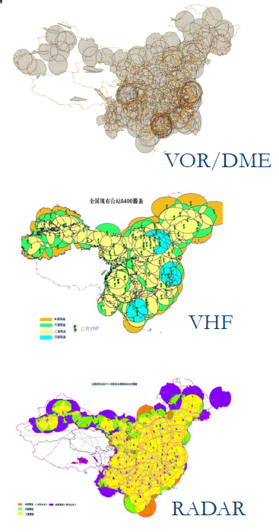
ATM Infrastructures
Communication
Air-GND: HF/VHF/Satellite, voice/data link
GND-GND: AFTN/Telephone, internet/Satellite
Navigation
Ground-based: VOR/DME, ILS
GNSS
Surveillance
Radar
ADS
Notes:
Aeronautical fixed telecommunication network (AFTN). A worldwide system of aeronautical fixed circuits provided, as part of the aeronautical fixed service, for the exchange of messages and/or digital data between aeronautical fixed stations having the same or compatible communications characteristics.

Slide 5
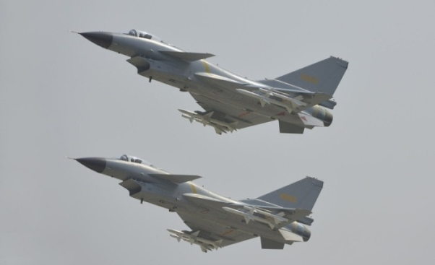
Types of Air Traffic
Commercial air traffic – Safety, Regularity
Military air traffic – Priority?
General Aviation Traffic (GA) – accessibility
General Air Traffic (GAT)
all flights conducted in accordance with the rules and procedures of ICAO and/or the national civil aviation regulations and legislation. GAT can include military flights for which ICAO rules and procedures satisfy entirely their operational requirements.
Operational Air Traffic (OAT)
encompasses all flights which do not comply with the provisions stated for GAT and for which rules and procedures have been specified by appropriate national authorities. OAT can include civil flights such as test-flights, which require some deviation from ICAO rules to satisfy their operational requirements.

